Slide 1


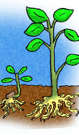
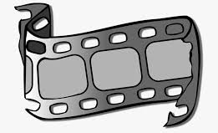
FINE ARTS THEATER PORTFOLIO
CORE SUBJECT: SCIENCE
GRADE: KINDERGARTEN
CARRIE SALVATORE

Slide 2
SCIENCE TEK
§112.11. Science
(D) In life science, students recognize the interdependence of organisms in the natural world. They understand that all organisms have basic needs that can be satisfied through interactions with living and nonliving things. Students will investigate the life cycle of plants

Slide 3
THEATER TEK
2) Creative expression: performance. The student interprets characters using the voice and body expressively and creates dramatizations. The student is expected to:
(A) demonstrate safe use of movement and voice;
(B) assume roles through imitation and recreation;
(C) identify the characteristics of dramatic play; and
(D) participate in dramatic play.

Slide 4

Lesson plan
3315 Lesson Cycle Template
Engagement/Connecting to Prior Knowledge | Good morning class! Who here has seen a flower or a plant? Can you tell me some examples? (have them list about plants at their home/at school/on a farm etc.) That’s amazing! You already have seen so many plants!
Teaching Point | “Today, I want to teach you about the life cycle of a plant and the stages that it must go through to be able to grow.” Today we are going to go walk slowly back to the reading corner and go read the book “The Amazing Life cycle of plants” By Kay Barnham! *Read Book*
Teach | After finishing the book … Today we are going to set up and grow our own plants in class today to understand the different stages that the plant will be going through all through the rest of the school year in our magic bean plant corner across from the theater center. I will demonstrate the steps to set up your plant cup repeat what I do in the same order and follow along. First, grab a cup and scoop in some soil Then, take your index finger and push a hole done into the soil but not all the way to the bottom of the soil and cup Then, place the bean seed into the hold and cover with the soil surrounding it. Then, grab the watering can and water your cup till a little water comes out the tiny holes on the bottom. Then, go place on the shelves in the magic bean plant corner to allow for the plants to get healthy sunlight which they need to grow healthy and strong. Finally, continue to water the plant on its own watering schedule and keep up with the growth habits.
Active Engagement | Now it’s your turn to try it out and demonstrate your understanding of the life cycles of a plant. First we will have a live dance performer come in and show you a dance with music to the life cycle of a plant and then she will teach you a small part of it to give you ideas for what you want to do for your part of the assignment. *Performer Artist comes and performs* Now you will form groups of no more than 4 or 5 to act out all the various stages of a plants life cycle from start to finish and explain the theater drama production as they act it out. Then when you are finished, you and your group will reflect on your performance and self reflect on your demonstration and whether you felt like your demonstration matched your understanding of the topic.
Link/Check for understanding | “Today we learned that plants go through various and certain life cycle changes and stages to become a full adult plant and then repeat the stages in their lifetime.” Tell me something you learned throughout the lesson or active performances we put on in class. … * Amazing you sound very comfortable with the life cycle of a plant now! Look around your environment now and tell me something the next school day!

Slide 5
FORM OF drama/music/DANCE
The students will learn about the life cycle of a plant and all the different stages it must go through to grow and become a healthy plant. Once the teaching is done, the students will be asked to demonstrate and perform their understanding and comprehension of the lesson through forming performance groups to act out the life cycle of a plant and show all stages the plant must go through to grow. Students will form groups of no more than 4 or 5 to act out all the various stages of a plants life cycle from start to finish and explain the theater drama production as they act it out. Then when they are finished, they will reflect on their performance and self reflect on their demonstration and whether they felt like their demonstration matched their understanding of the topic.

Slide 6
THE PLANT SONG
https://youtu.be/N-l-gsWOKzk

Slide 7
Local visiting dancer/performer
    Katie Salvatore
    Graduated Baylor University
    Northwestern University for Graduate School
    Focus in Dance/Music
    Current Residence Spring, TX
    I chose this visiting artist because they are local, and they have a good background for both dance and music being in their degree certification. I would give them a brief overview of the Science lesson of the life cycle of plants that they are learning in class to Ms. Salvatore and then ask her to show the class a dance to the life cycle of a plant and then have her teach the students part of it to them alongside music. I will make sure she addresses all the important milestones a plant goes through when growing into an adult plant from a seedling. Ms. Salvatore’s visit will extend and support my teaching in the classroom by reiterating the different stages a plant goes through in easier to follow along dance moves and steps to the music so the children can make more meaningful connections to the performance. This relates to the kindergarten grade level and objectives for both Theater and Science due to the performer being a dancer and presenting the movements alongside music for a full movement production and performance while teaching and re instilling the lesson on the life cycle of a plant to meet the science objective for the students. The performer is easily locatable, and I have easy access to invite them to my classroom. The performer meets the criteria and standards for being able to visit the classroom through their educational background and dance background.

Slide 8
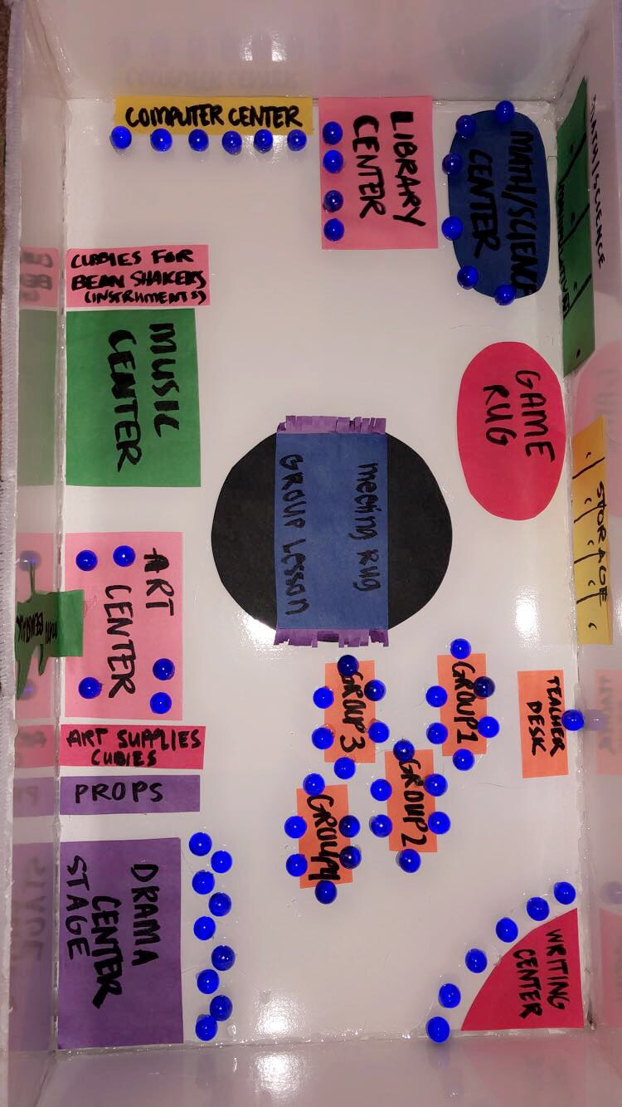
Theater floor plan

Slide 9
Center information
GOAL
The goal and purpose of the center is to get the students actively engaged and involved in creating a visual representation of what they have learned about the life cycle and stages of a plant.
SKILLS
Students will develop good communication skills with classmates through discussing and practicing their dramatic presentation. They will be practicing performance etiquette with their fellow peers in class. Students will practice healthy interactions with group members in deciding how to come up and prepare their life cycle of a plant performance. The students will also be practicing their acting skills.
MATERIALS
Some basic materials will include possible paper for students to make backdrops or background props for their performances. Sticks, construction paper, markers, glue etc. for making plant and life cycles props for each stage that the students could hold up and use as masks etc. that they could make ahead of time for this activity and lesson plan.
GUIDELINES & BEHAVIORAL EXPECTATIONS
Students will show an understanding of the life cycle of a plant and be able to verbally explain the concept to the teacher to be able to take part in the drama and theater center. The students will ask for permission to use any props and materials before starting on the presentation and preparing for their performance. The students will also be held accountable for clean up of the theater station and center if they want to be able to use it for multiple lessons they learn throughout the year.

Slide 10
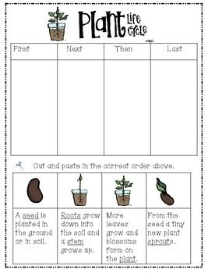
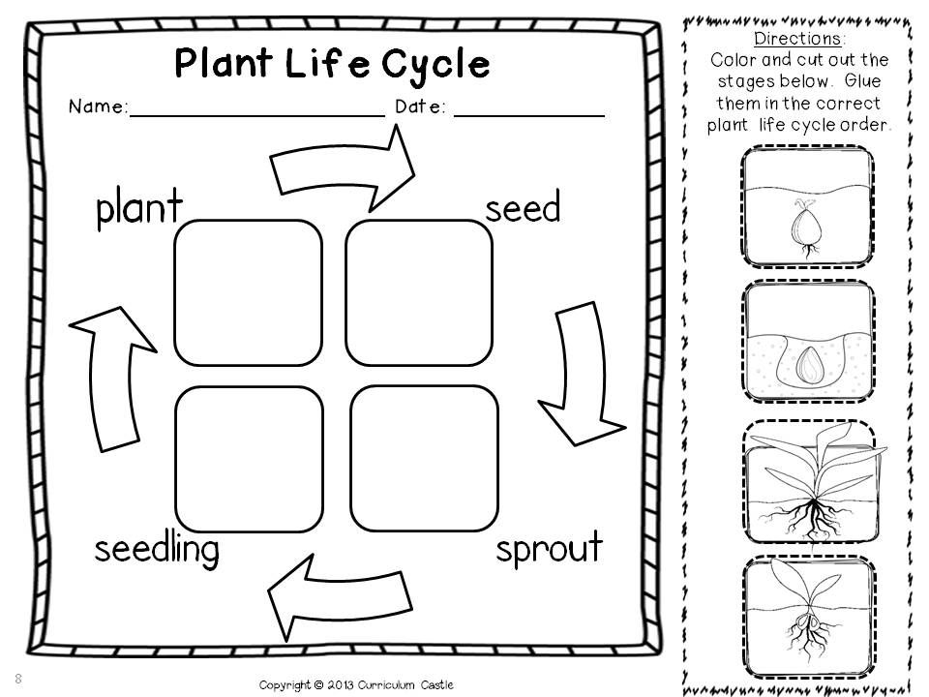
Assessment instruments
The overall purpose of these two assessments will be to assess the overall understanding and comprehension of each student over the life cycle of a plant. These will allow to see if the child understands the various stages the plant must undergo in its life span to grow healthy and continue to repeat this cycle over and over. I will use these two assessments at the end of the life cycle of a plant lesson to conclude on the idea that plants undergo various stages and changes throughout their plant life.
I will initiate these assessments to allow for the children to be hands on with cutting or labeling and coloring which will allow for them to make personal decisions and connect back to any meaningful connections they made through the life cycle of a plant lesson either in class through the acting drama presentations or through the visiting artist that performed for the whole class and got everyone extremely excited for science and plants.

